Slide 1

T-SAM: Text Self-Attention Maps
Understanding Diffusion Models and Semantic Alignment
Student Name : Udit Jain
Roll No. : 24CSM1R23

Slide 2
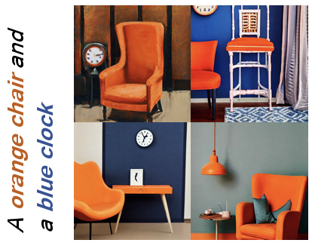
What is Text-to-Image Generation?
•
Text → Image using diffusion models.
•
Used in art, design, prototyping, automation.
•
But they still struggle with semantic alignment.
“Text-to-image diffusion models... can generate beautiful images... But even today, they often misunderstand what we are trying to describe.”

Slide 3
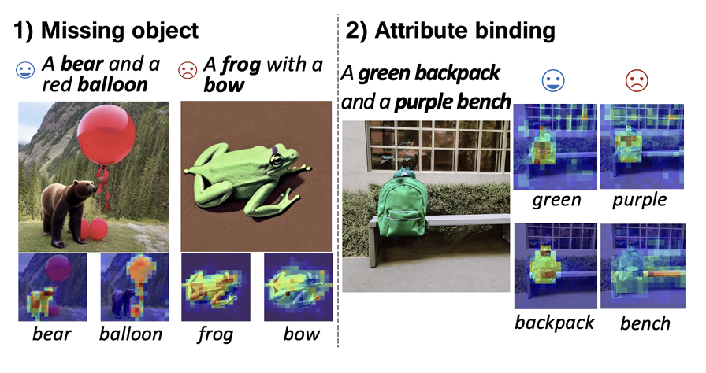
Motivation: Typical Failures
Prompt: “A black car and a white clock”
Common Errors:
•
Missing objects
•
Wrong color binding
•
Object–attribute confusion
•
Blending of multiple objects
“...the model may draw only one object, or swap the colors. This violation of meaning is called semantic misalignment.”

Slide 4
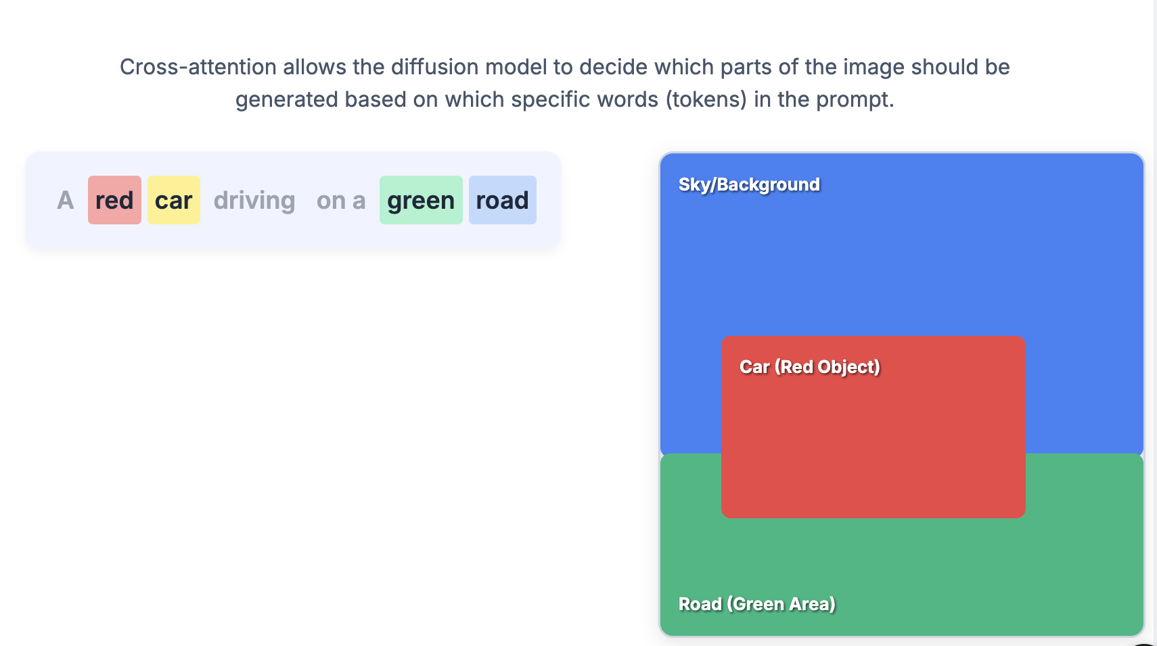
Background: Cross-Attention
•
Cross-attention links image pixels ↔ text tokens.
•
Controls what part of the image "listens to" which word.
•
Crucial for placing objects and attributes correctly.
“If cross-attention for ‘black’ overlaps with ‘clock’, the clock might incorrectly become black.”

Slide 5
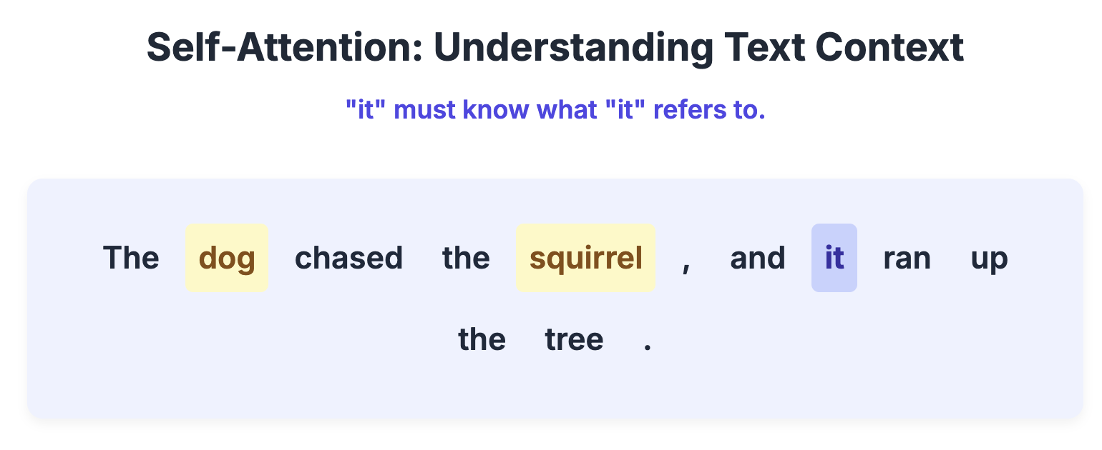
Background: Self-Attention (Text Encoder)
•
Self-attention captures word-to-word relationships.
•
E.g., “black → car”, “white → clock”.
•
This structure exists in the text encoder.
“The CLIP text encoder internally knows grammatical relations... But this information never reaches the image generator.”

Slide 6
Prior Work: Attend-and-Excite
Research Paper Details
Attend-and-Excite: Attention-Based Semantic Guidance for Text-to-Image Diffusion Models
Published in 2023 (arXiv) by Yuval Alaluf, Or Patashnik, and Daniel Cohen-Or — a method that boosts weak subject-token attention to prevent missing objects in text-to-image diffusion models.
https://arxiv.org/abs/2301.13826?utm_source=chatgpt.com
What They Did
Fixed the issue of missing objects in text-to-image generation.
Ensured all subject tokens (e.g., dog, car, cat) actually appear in the final image.
How They Did It
Monitored cross-attention maps during diffusion.
If a subject token gets weak attention, they boost it by adjusting the latent
representation using Gaussian kernel smoothing.
Simple inference-time plug-in — no retraining needed.
Limitations
Fixes object presence, but not attribute binding (colors, textures still get swapped).
Does not fully prevent object blending or spatial confusion.
Adds extra computation → slightly slower generation.

Slide 7
Prior Work: Linguistic Binding (SynGen)
Research Paper Details
Linguistic Binding - Semantic Guidance: Linguistically-Aware Control for Text-to-Image Diffusion Models (SynGen)
Published in 2023 (NeurIPS) by Rassin et al., uses an external syntax parser to align attributes with correct objects and separate wrong pairs, but is slow and breaks when the parser fails.
https://arxiv.org/abs/2305.03687
What They Did
Used an external syntax parser (like SpaCy) to extract correct attribute–object pairs.
Encouraged correct attribute–entity alignment and separation of incorrect pairs.
Improved attribute binding compared to plain diffusion baselines.
How They Did It
Parsed the prompt to identify which attributes modify which objects.
Added losses that pull together the attention of correct pairs and push apart wrong pairs.
Guided cross-attention maps during diffusion to match the linguistic structure.
Limitations
Heavily depends on the quality and accuracy of the external parser.
Fails when prompts are ambiguous, uncommon, or complex.
Adds extra computation and slows inference.

Slide 8
Prior Work: CONFORM / Attention Regulation
What They Did
Proposed attention regulation using contrastive constraints to better separate or connect token groups.
Improved control over attention maps during diffusion.
How They Did It
Manually created token groups (e.g., attribute–object pairs).
Applied contrastive losses to:
Increase attention overlap for correct groups
Decrease overlap for unrelated groups
Guided the model to maintain cleaner attention boundaries.
Limitations
Needs hand-designed token grouping, which is error-prone.
Can create hard, unnatural visual boundaries in images.
Not generalizable to complex or unusual prompts.
Research Paper Details
Conform: Contrastive Fine-Grained Attention Regulation for Text-to-Image Diffusion Models
Published in 2023 uses contrastive constraints to control attention maps and enforce token grouping, but it relies heavily on manual token design and often produces unnatural boundaries in the generated image. https://arxiv.org/abs/2305.13972

Slide 9
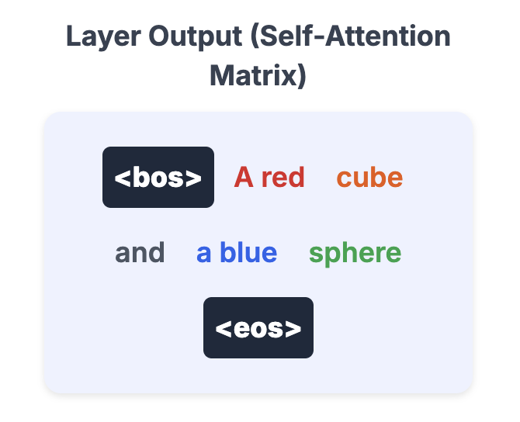
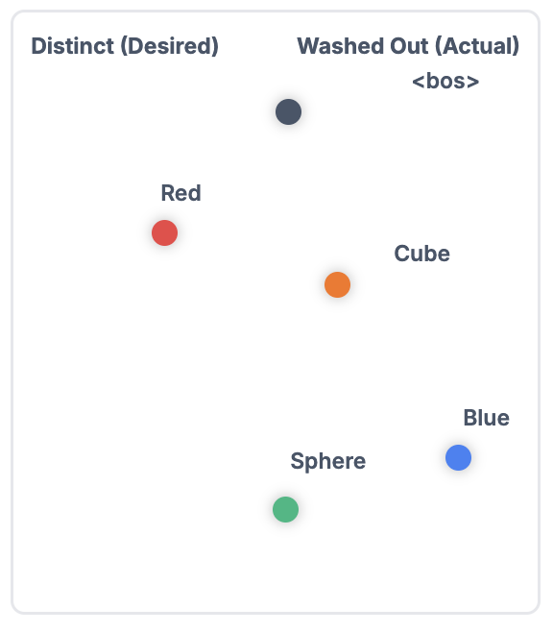
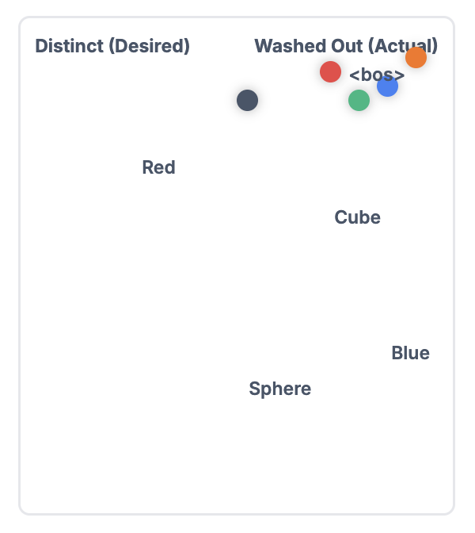
This Paper: Key Observations
“This paper shows that cross-attention blindly follows text embeddings. If embeddings for ‘black’ and ‘white’ look similar, then their attention maps overlap, causing color confusion.”
“The text encoder’s self-attention perfectly captures grammar. But due to the attention-sink effect, the final token embeddings lose these relationships, so the UNet never sees them.”
How it should be…
Final Token Embeddings

Slide 10
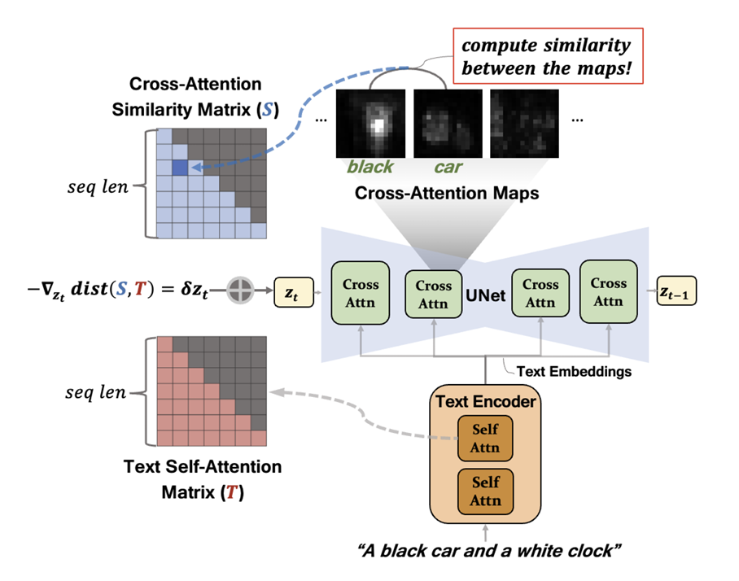
This Paper: T-SAM (Text Self-Attention Maps)
The core idea:
•
Extract text self-attention matrix T (the correct syntax).
•
Compute cross-attention similarity matrix S (image meaning).
•
Aim: Make S match T.
The idea:
Use the self-attention matrix T... and guide cross-attention S... to match it.

Slide 11
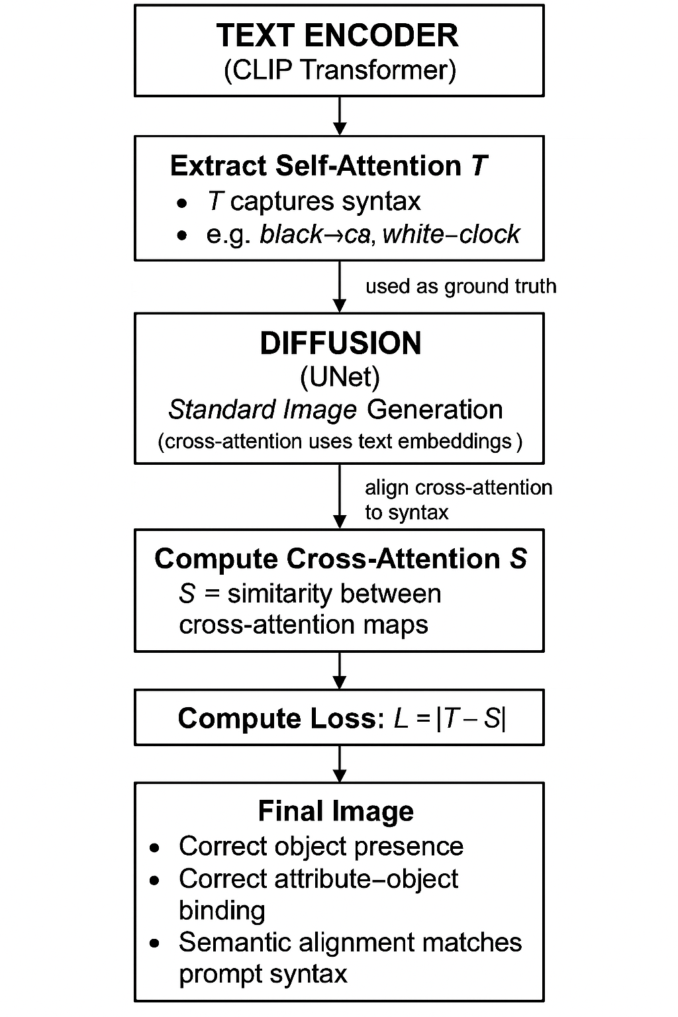
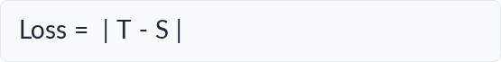
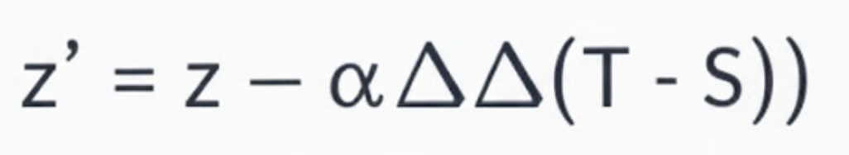
This Paper: Optimization
(Simple Loss)
A simple loss is applied:
A small gradient update nudges the latent z:
“They do not retrain the model. They simply nudge the latent at a few early denoising steps...”
Pipeline

Slide 12
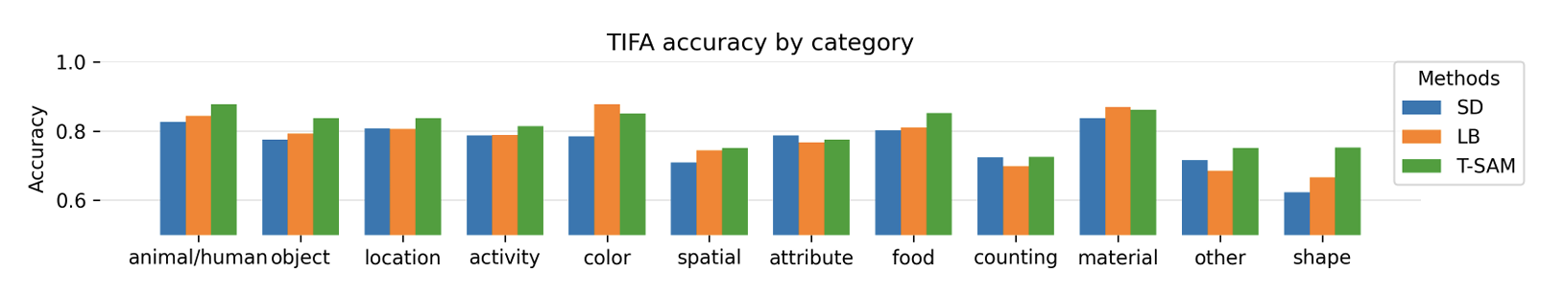
Experiments (TIFA Benchmark)
TIFA Score refers to a reference-free metric used for evaluating the faithfulness of text-to-image generation models
•
Tested on 4000+ natural language prompts.
•
T-SAM improves TIFA score significantly.
•
Handles colors, shapes, relations better than baselines.
“On the TIFA benchmark, T-SAM outperforms prior approaches across categories like color, shape, and relation understanding.”

Slide 13
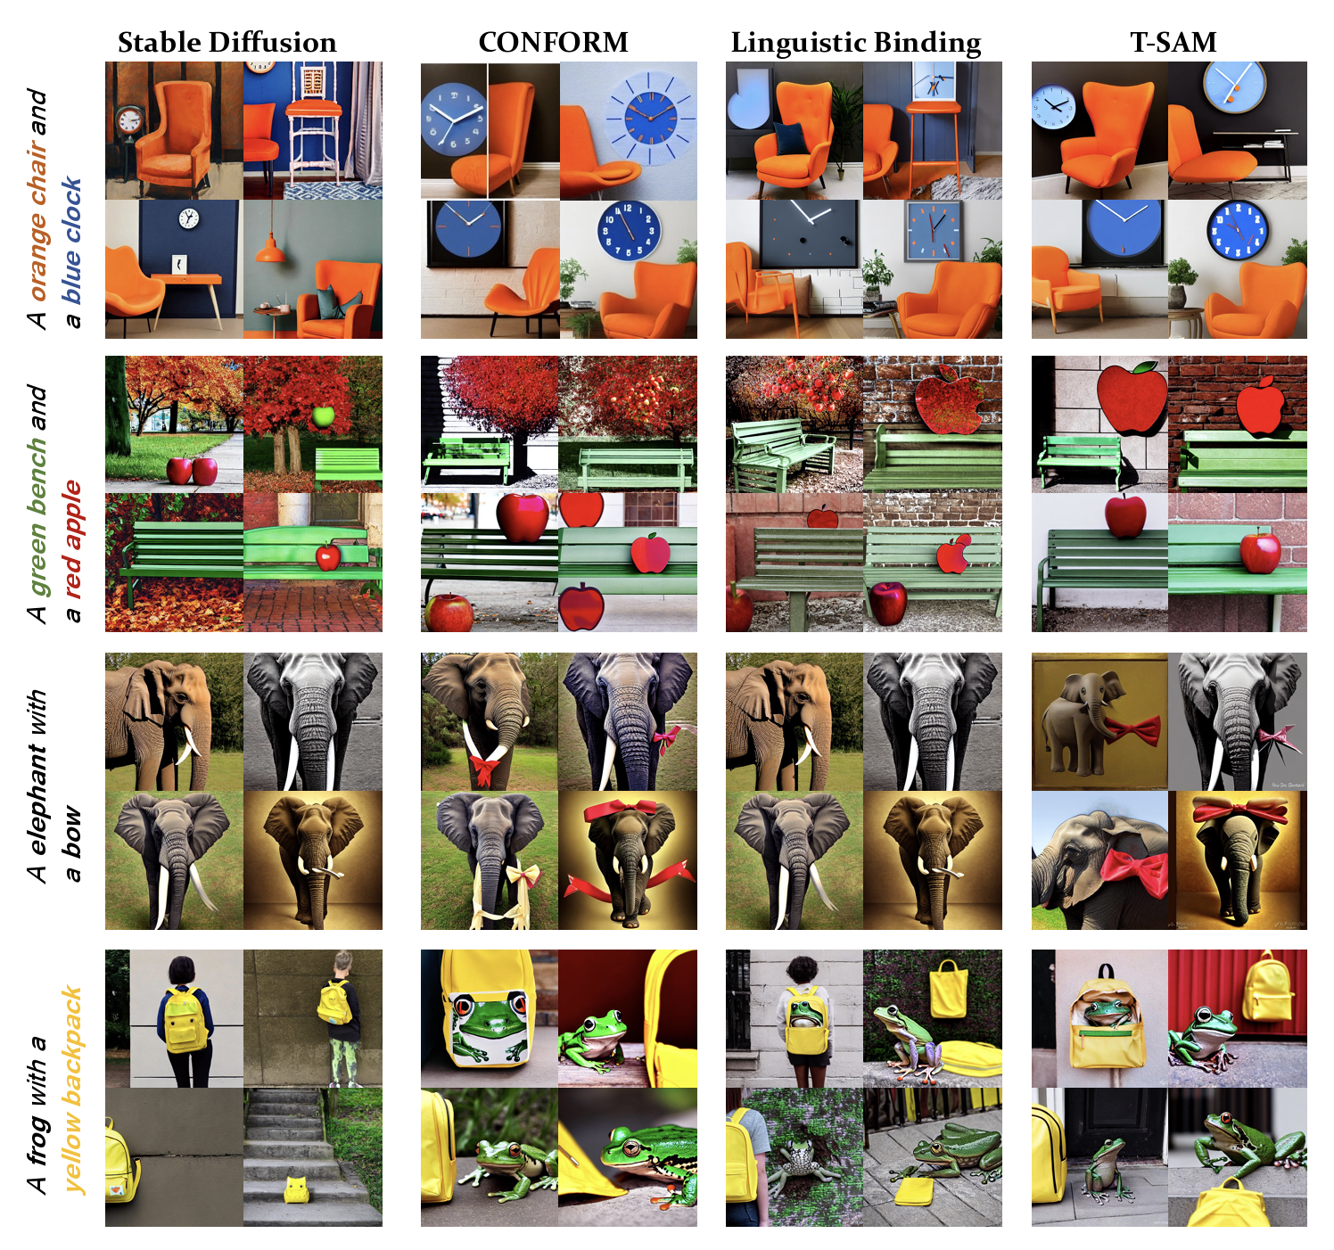
Results
T-SAM consistently improves semantic alignment, fixing wrong attribute–object bindings and reducing missing-object errors across diverse prompts.
It achieves higher TIFA scores compared to Attend-and-Excite, Linguistic Binding, and CONFORM.
The generated images show clearer object separation, correct color mapping, and better adherence to textual syntax without any model retraining.

Slide 14
Conclusion
T-SAM shows that self-attention already contains perfect grammar, but diffusion models fail to use it.
By softly aligning cross-attention with text self-attention, T-SAM fixes semantic misalignment without retraining, without parsers, and without modifying the model.
It improves object presence, attribute binding, and relational reasoning across diverse prompts.

Slide 15
Future Direction
Faster approximation of T → S alignment.
Multi-sentence or story-level alignment.
Quote: “The next step could be integrating visual constraints, improving efficiency, and extending syntax to long paragraph-level prompts.”

Slide 16
Summary & Evolution of Alignment
Summary
Linguistic Binding
"Simpler, cleaner, and more general... extracts syntax from the model's own self-attention."
Attribute–entity mapping via an external parser.
Attend-and-Excite
T-SAM (This Paper)
Ensures object presence. Solves missing objects.
Parser-free, self-contained syntax transfer.

Slide 17
Thank you.

